Slide 1
Web Application Architectures

Slide 2
Client-Server Model
The Client-Server paradigm is the most prevalent model for distributed computing protocols.
It is the basis of all distributed computing paradigms at a higher level of abstraction.
It employs a request-response protocol.

Slide 3
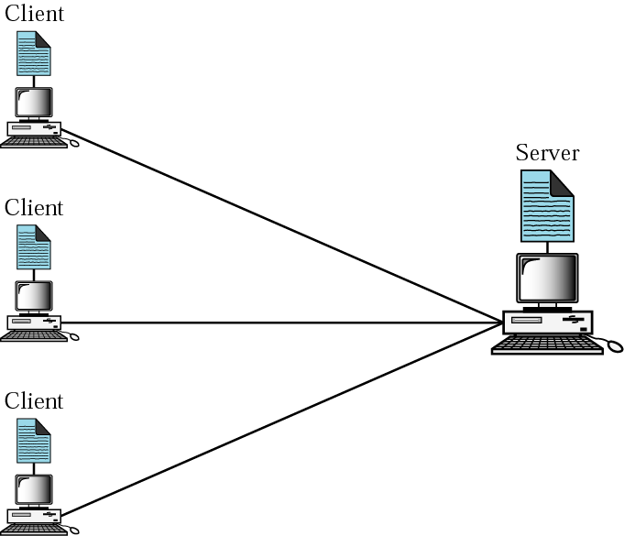
Client-Server Model
Servers
Run all the time (i.e. infinite)
Provide service to any client
Typically specialize in providing a certain type of service, e.g. Mail.
Listen to a well-known port and passively open connection.
Clients
Run when needed, then terminate (i.e. finite)
Actively Open TCP or UDP connection with Server’s socket.

Slide 4
Web Based Applications
Web based Applications are special Client-Server applications in which Client is a Web Browser and services are hosted by a Web Server.
“A web based application is a software package that can be accessed through the web browser. The software and database reside on a central server rather than being installed on the desktop system and is accessed over a network.”
A common example is web-based email. ie, Hotmail, Yahoo! mail or google’s web mail.

Slide 5
Web Based Application
Application runs server side (CPU, disk space, configuration)
No install, packaging, CDs, upgrades, configurations or tweaking of settings on the client side.
Greater responsibilities and control placed in the hands of the system administrators (as opposed to the users)
Data is likely more secure (stored server side, w/ proper security measures and backup)
Machine independent (any user can log in from any computer).

Slide 6
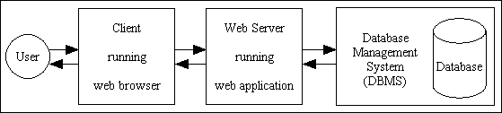
Web Application

Slide 7
Layered Architecture
In order for application to be called multi-layered it is the application on its own –
Excluding all external components such as
the browser and
the database –
The web browser can operate independently of the application, therefore it is not part of the application.
Although it is possible for application code to be executed in the client's browser, such as JavaScript, Flash, or ActiveX controls, their usage is entirely optional and can be disabled.
The database server can also operate independently of the application, therefore it is not part of the application.
Although it is possible for application code to be executed in the database, such as database triggers and stored procedures, their usage is entirely optional and can be disabled.

Slide 8
Layered Architecture
Layers: grouping the common functions
Benefits of layers:
Simplicity: easy to design, once layers and their interaction are defined clearly
Flexibility: easy to modify and develop networks by separate layers modifications
Incremental changes: add new layers, add new functions to a layer
Each layer carries out a specific set of functions using its own protocol, and builds on the services of the layer below it (provides a service to its upper layer).

Slide 9
Architecture of Web Applications
Business (or Application) Logic
Data Access Logic (Resource)
Graphical User Interface (Presentation)

Slide 10
Explanation of keywords
Business Logic: Rules governing the business. These can change frequently depending upon the business.
handles data validation, business rules and task-specific behaviour.
Data Access Logic: Contains the data relevant for the business. communicates with the database by constructing SQL queries and executing them via the relevant AP
Graphical User Interface (UI): Provides the platform for interaction of the user with the system.
It displays data to the user and accepts input from the user. In a web application this is the part which receives the HTTP request and returns the HTML response.

Slide 11

Tiers of a Web Application
browser
Client
Presentation
tier
<html>
...
</html>
Visualise
Application
logic tier
information system
Calculate
Data Access Logic
tier
Store

Slide 12
Difference between Logic and Data
There is a big difference between passing information to another component which can be construed as an instruction and actually executing that instruction.
Instruction is merely a piece of data, a piece of information, and the "logic" only exists in that component which executes that instruction in order to produce a result.
Declarative programming - where you describe what the program should accomplish but without defining when or how those instructions should be implemented.
Imperative programming - where instructions are actually implemented in the designated sequence.

Slide 13
Example
"display field X as a dropdown list"
Business layer may contain a piece of data which says this instruction but that is not presentation logic which is executed within the Business layer.
Presentation logic is that piece of program code which actually constructs the HTML for the dropdown list.
All the Business layer is doing is generating an instruction in the form of meta-data which is passed to the Presentation layer where that instruction is actually executed.
It is only when that data is processed by the program code in the Presentation layer that the output is actually constructed, and it is the code which produces that output and returns it to the client which is presentation logic.

Slide 14
Presentation Tier
Web Application needs to communicate with external entities, human users or other computers
Allows these entities to interact with the system
Implemented as a Graphical User Interface (GUI) interface
How the data should appear to the user and how the user should interact with the interface
handles data validation, business rules and task-specific behaviour.

Slide 15
Presentation Tier
Referred to as the client of the web application – which is not correct
Example:
Application accessed by web browsers using plain HTML documents
The client is a web browser that only displays information prepared by the Web server
The presentation layer in this case is the Web server

Slide 16
Application Logic Tier
Web Applications do more than information delivery, they perform data processing (Business Logic & calculation) behind the results being delivered
Example:
A program that implements a withdrawal operation from a bank
This program takes the request, checks whether there is enough funds, verifies whether withdrawal limits are exceeded, creates a log entry for the operation, performs the operations against the current balance and gives approval for handing out the money.
Here the algorithms (Business Rules) are implemented
This tier is often referred to as
Services
Business logic
Business rules

Slide 17
Resource Management Layer
Web Application needs data to work with
Data can reside in databases or other information repositories
Deals with and implements different data sources of Information Systems
Also referred to as the data access layer, which indicates that it is implemented using a Database Management System
From the banking example:
The Resource Management layer could be the account database of the bank

Slide 18
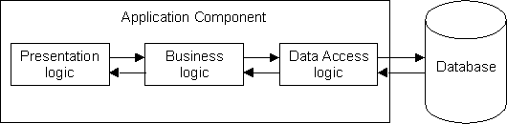
The 1-Tier Architecture
Mainframe-based and the system took place through dumb terminals
Monolithic Information Systems
Presentation, application logic, and data access logic merged into a single tier
Even today fits needs of some users
Due to its monolithic nature it did not provide an entry point from the outside except the channel to the dumb terminals

Slide 19
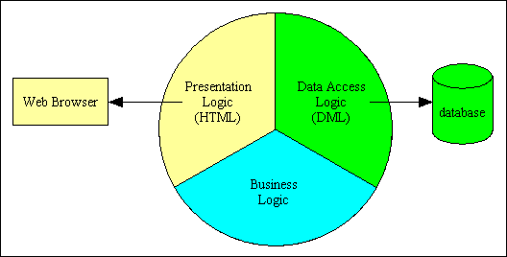
The 1-Tier Architecture Example

Slide 20
1-Tier Architecture
Disadvantages
Monolithic pieces of code (high maintenance)
Hard to modify – lack of documentation and qualified programmers
Not scalable
Don't protect valuable "Business Logic“
Centralized Data Storage
No data redundancy (no duplication of data)

Slide 21
2 - Tier Architectures
Separation of presentation layer from other 2 layers (app + resource)
Client/server systems with thin clients/fat clients
1st Tier
2nd Tier
Database
Presentation Logic
Business
Logic
Data Access Logic

Slide 22
The 2-Tier Architecture
Advantages:
Protects business logic from UI
Disadvantages:
Increased network traffic
Application logic can’t be reused
limited scalability

Slide 23
3 - Tier Architectures
2-Tier architecture created islands of information where a set of clients could communicate with a server but not with other servers
3-tier made it technically possible to integrate different servers
Separating Data Access Layer from application logic layer
Lead to the introduction of clear RM layer interfaces
Good at dealing with integration of different resources

Slide 24
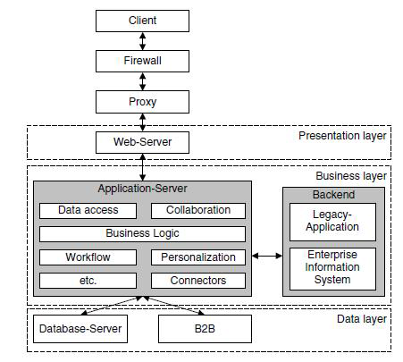
The 3-Tier Architecture

Slide 25
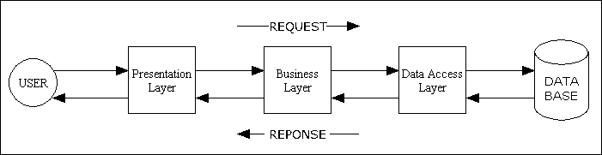
The 3-Tier Architecture
The Presentation layer requires skills such as HTML, CSS and possibly JavaScript, plus UI design.
The Business layer requires skills in a programming language so that business rules can be processed by a computer.
The Data Access layer requires SQL skills in the form of Data Definition Language (DDL) and Data Manipulation Language (DML), plus database design.

Slide 26
The 3-Tier Architecture
Advantages
Clear separation of user-interface-control and data presentation from application-logic.
Change in business logic wont need change in other layers.
Dynamic load balancing by use of multiple servers
Scalability by running each layer on a different server
Additional tier for integration logic
Flexibility

Slide 27
Rules of the 3 Tier Architecture
The code for each layer must be contained with separate files which can be maintained separately.
Each layer may only contain code which belongs in that layer. Thus business logic can only reside in the Business layer, presentation logic in the Presentation layer, and data access logic in the Data Access layer.
The Presentation layer can only receive requests from, and return responses to, an outside agent. This is usually a person, but may be another piece of software.
The Presentation layer can only send requests to, and receive responses from, the Business layer. It cannot have direct access to either the database or the Data Access layer.

Slide 28
Rules for 3 tier architecture
The Business layer can only receive requests from, and return response to, the Presentation layer.
The Business layer can only send requests to, and receive responses from, the Data Access layer. It cannot access the database directly.
The Data Access layer can only receive requests from, and return responses to, the Business layer. It cannot issue requests to anything other than the DBMS which it supports.
Each layer should be totally unaware of the inner workings of the other layers. The Business layer, for example, must be database-agnostic and not know or care about the inner workings of the Data Access object. It must also be presentation-agnostic and not know or care how its data will be handled. It should not process its data differently based on what the receiving component will do with that data. The presentation layer may take the data and construct an HTML document, a PDF document, a CSV file, or process it in some other way, but that should be totally irrelevant to the Business layer

Slide 29
Choice of technology
Presentation
HTML/XHTML
CSS
Flash
Javascript
Java
CSS
Voice
Business Logic
PHP
ASP
JSP
Cold fusion
Data Access Layer
SQL
JPA (Java Persistence API)
Hibernate

